Slide 1
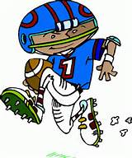



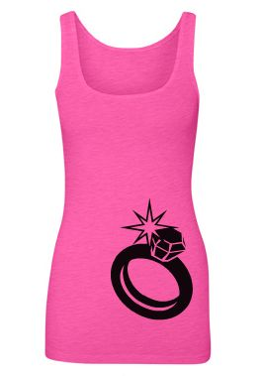
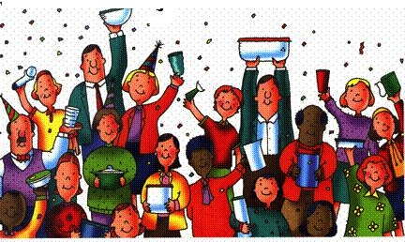



Tic Tac Tupper
One Tic Tac Tupper= __________________
Two Tic Tac Tuppers = __________________
Three Tic Tac Tuppers = __________________
Black out = __________________
Have $200.00 in Outside Orders Before Your Party | Have one guest that has a child playing sports/ band/ cheer | Take 20 minutes to hear the facts about opening your Tupperware account
Have 3 new faces--- 3 people I’ve never met | Have 10 adult guests in attendance | Have one guest that is engaged to be married or has a son/daughter engaged to be married
Have one guest that is a mother of a preschooler or expecting | Send me your Wishlist before The party begins | Have a Dating Waiting (Someone That is Ready to Date a Party before we begin)

