Slide 1

AUTUMM
HOST COACHING MEMES
1-2-3
HOST COACHING
AS EASY AS
3 CHALLENGES FOR YOUR HOST

Slide 2

THANK YOU!
For hosting a Tupperware party with me!
1-2-3
EARNING YOUR WISHLIST
FREE IS AS EASY AS
Let’s have FUN working together to give you the most gifts
possible!

Slide 3
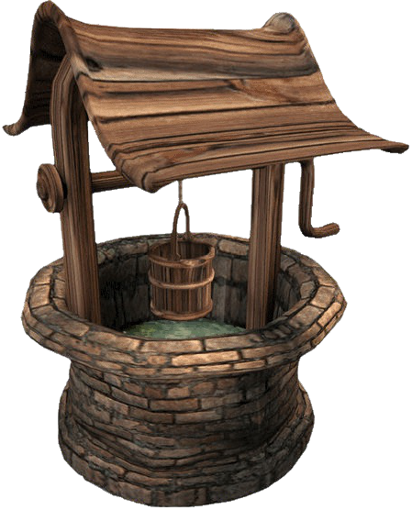
1. YOUR WISHLIST
I WANT TO KNOW EXACTLY WHAT YOU WANT!
START YOUR PARTY BY ADDING
10+ ITEMS FROM OUR CATALOG TO YOUR WISHLIST!
Once I have your wishlist we
will make your guest list together!
GET YOUR FIRST GIFT BY COMPLETING THIS CHALLENGE!

Slide 4


Slide 5


Slide 6
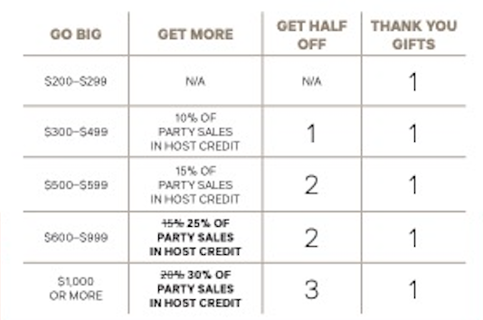
HOSTS
always gather
the best deals!
THANK YOU GIFTS
HOST CREDIT &
HALF-PRICE PRODUCTS
USE YOUR HOST CREDIT TO PURCHASE A HOST EXCLUSIVE!

Slide 7


2.
LET’S
SCURRY
SEND ME YOUR LIST OF 50+ GUESTS WITHIN 24 HOURS TO RECEIVE YOUR SECOND GIFT!!
WHO DO YOU KNOW THAT…
Likes to be organized
Enjoys a healthy lifestyle
Likes to save money
Environmentally conscious
LOVES Tupperware® Products
WAIT FOR MY WORD CHOICES BEFORE YOU REACH OUT!

Slide 8

HELP YOUR GUESTS FEEL LOVED BY:
Sending a personal message. Avoid group chats and the “invite” button
Asking permission to send the invite AND by linking them to the group
Following up within 24 hours so they know you care and want them there.

Slide 9

3. DON’T “LEAF”
ANYONE OUT!
COLLECT 5 ORDERS PRIOR TO YOUR PARTY FROM THOSE THAT YOU KNOW CAN’T ATTEND!
TURN IN BEFORE THE START OF THE PARTY TO EARN YOUR THIRD GIFT!

Slide 10

HARVEST
YOUR CROP
Who said yes, but didn’t join in?
Today is the day to check with them using my word choices
People get busy. Life happens.
Don’t assume they aren’t interested.
Show them they were missed!

Slide 11

BEE ACTIVE IN YOUR PARTY
Help each guest turn on group notifications and find the party posts
Comment on all the posts and play the games
Tag people you think may be interested in posts I share
Encourage friends to hold the next party so they can earn FREEBIES too!
EARN 15% OFF ANY FULL PRICE ITEM OR SET FROM THE CATALOG WITH EACH FRIEND WHO JOINS MY TEAM! EARN 25% OFF YOUR ENTIRE ORDER WHEN YOU JOIN!

