Slide 1

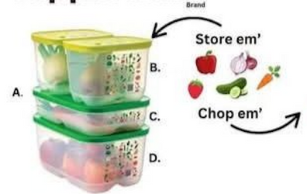
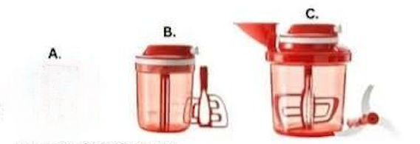
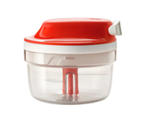
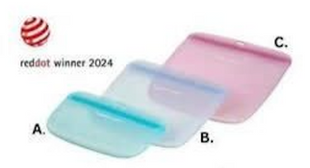
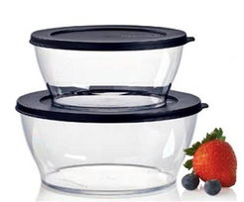
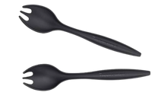
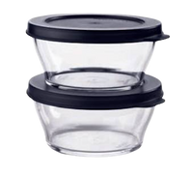
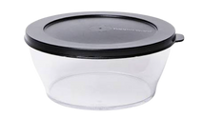
Prep, Store, & Save to Eliminate Waste
Offers good Aprit 1-30, 2025, or while supplies last.
SuperSonic™ Choppers
It's time to chop, mix, stir, and blend without the hassle... or the need for electricity. Our SuperSonic™ Choppers are designed for efficiency, helping you tackle meal prep in seconds. Chop 5X faster than experienced chefs!
  SuperSonic Chopper Compact Clear, 1.25 cups, #1315, $50
  SuperSonic Chopper Tall, 3 cups, #1316, $59
  SuperSonic Chopper Extra, 5.5 cups, #1317, $87
FridgeSmart® Containers
Perfect storage conditions for all your favorite vegetables & fruits using
Tupperware's ACE™ (Atmosphere
Controlled Environment) system: a special three-way vent and custom base help regulate the atmosphere inside the container by balancing the flow of oxygen coming in and carbon dioxide going out.
  4-Pc. Starter Set, #670, $99
  Small Deep, 1.75 qt., #667, $21
  Medium, 1.75 qt., #668, $26
  Medium Deep, 1 gal., #669, $31
Ultimate Silicone Slim Bags
Our versatile, leak proof, and reusable slim silicone bags allow you to store food with confidence: organize, carry, and even freeze, without compromising your lifestyle.
Every Ultimate Silicone Slim Bag replaces 520 single-use plastic bags. Less plastic in the environment means more practicality in your routine-it's a win-win!
Attend a party
to learn about additional
sales specials!
  Mini, 1.25 cups, #691, $8
  Medium, 3 cups, #692, $12
  Large, 5.5 cups, #693,
Clearly Elegant Collection...durable, space-saving essentials that keep food fresh and mealtime simple.
These durable, glass-inspired bowls are built to handle it all-from storing leftovers to serving meals. Their leak-resistant seals, stackable shape, and space-saving design help keep food fresh and your kitchen organized. Paired with ergonomic, serving forks for easy serving and compact storage, this set is a go-to for everyday use, without the need for constant replacements.
Serving Forks
#1585, $12
Clearly Elegant
2-Pc. Round Set Includes two 2 cup bowls. #1584
SALE $15 (Reg. $20)
Your Tupperware Consultant
Clearly Elegant
2-Pc. Serving Set
Includes one 5.5 cup & one
10 cup bowl. #88814
SALE $39 (Reg. $50)
Clearly Elegant
5.5 cup Bowl
#1583, $20

