Slide 1
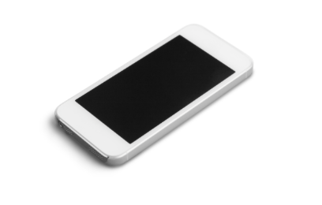
PHON-A-THON
Who: You-and anyone you’d like to share this with!
What: A one-day sale...done over the phone!!! \
No gas needed! No parking hassles!
When: ________
Time: ________
Why: It’s Tupperware's 80th Anniversary!
I'm striving to break my record!
How: Visit my website and check out all the great specials!
*Call me between ___________ and receive your discount,
even on sales items! Your discount is based on when you call!
8am-8:59am= _______________
9am-9:59am= _______________
10am-10:59am=_______________
11am-12noon=_______________
If the line is busy, please leave your name, your items you'd like to order and a phone number where you can be reached. I
will call you back to confirm your order and take your payment information.
Your Tupperware Consultant,

